Slide 1
SSID: AI IMMERSION
Password: MSFTWIFI

Slide 2
Building Intelligent SaaS Applications in Azure
Julie Strauss
Bill Gibson
Debra Dove
Lukasz Pawlowski
Ron Ortloff
Liam Cavanagh
SSID: AI IMMERSION
Password: MSFTWIFI
Notes:
SSID: AI IMMERSION
Password: MSFTWIFI

Slide 3
Workshop Goals
Learn how to use design and management patterns to accelerate development of intelligent, multi-tenant SaaS apps
Learn how to use a data warehouse to gain business and operational insights from vast amounts of data distributed across potentially thousands of tenant databases
Learn how machine learning can provide predictions
Learn how interactive business analytics can improve customer value
Learn how advanced search can increase traffic and customer value
Notes:
This slide is required. Do NOT delete. This should be the first slide after your Title Slide.
This slide should describe what your goals are for this session. This information lets your audience know what you are trying to accomplish with your talk or tutorial—ie, what value will attendees get by investing 25 minutes or 2 hours of their time listening to you.
You should not spend more than 1 minute presenting this slide.
General examples of session goals could be (you will have to create your own specific goals):
Introduce a new technique or approach to solve a customer problem
Compare two approaches and explain why one is superior
Describe a project and the learnings that audience members can apply from it
Teach audience members how to use a specific technology

Slide 4
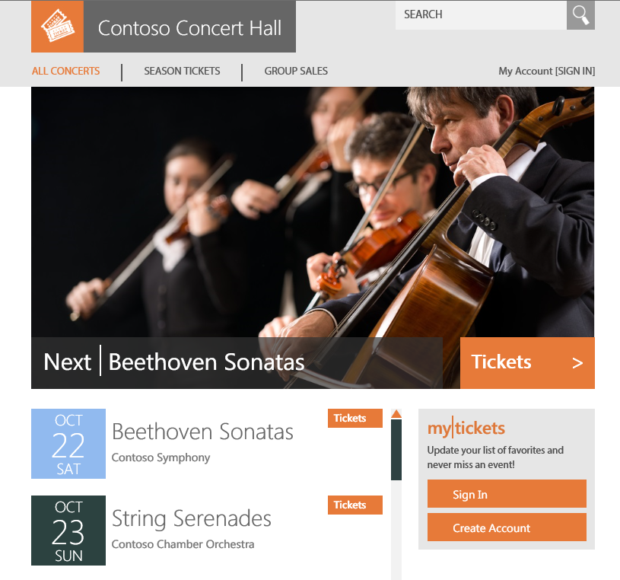
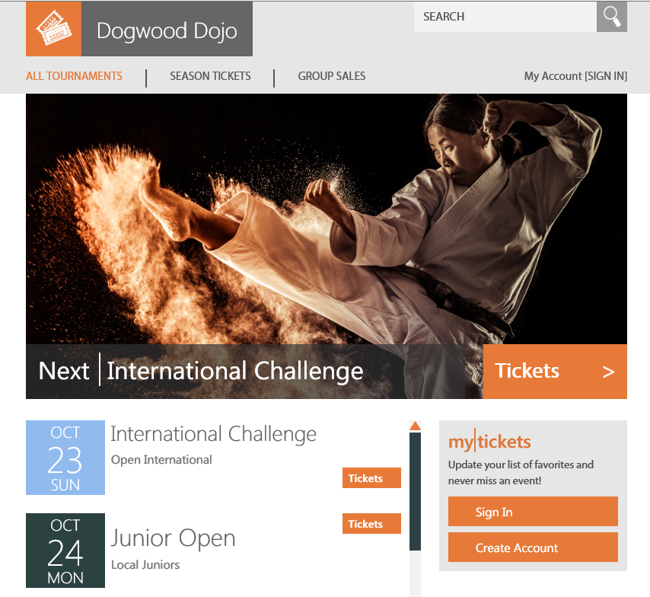
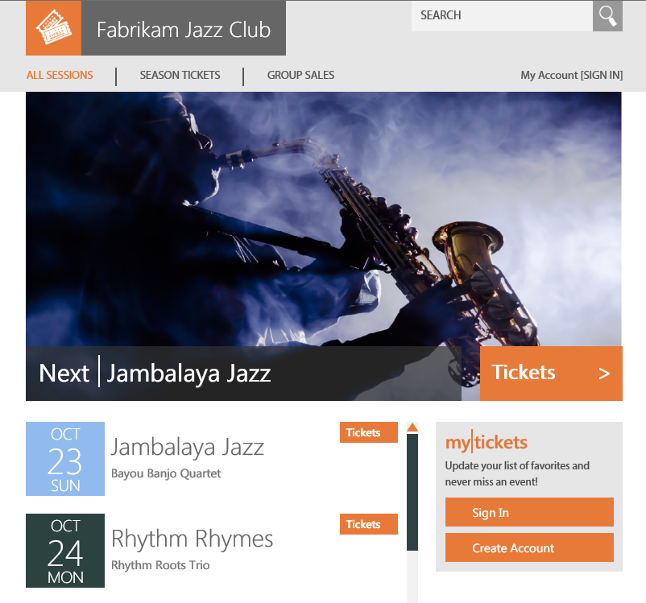
Introducing the “Wingtip Tickets Platform” sample

Slide 5
One SaaS scenario, five chapters
Developing SaaS app on SQL Database using SaaS patterns
Using SQL Data Warehouse to extract insights from tenant data
Using Machine Learning to predict and impact future ticket sales
Using Power BI embedded to provide interactive analytics
Using Azure Search to increase traffic for a SaaS application
Interactive and engaging many demos and hands-on labs
Notes:
This slide is required. Do NOT delete. This should be the first slide after your Title Slide.
This slide should describe what your goals are for this session. This information lets your audience know what you are trying to accomplish with your talk or tutorial—ie, what value will attendees get by investing 25 minutes or 2 hours of their time listening to you.
You should not spend more than 1 minute presenting this slide.
General examples of session goals could be (you will have to create your own specific goals):
Introduce a new technique or approach to solve a customer problem
Compare two approaches and explain why one is superior
Describe a project and the learnings that audience members can apply from it
Teach audience members how to use a specific technology

Slide 6
Using SaaS patterns to accelerate app development on SQL Database

Slide 7

Azure SQL Database
Intelligent, fully managed database-as-a-service
Azure
SQL Database
Database provisioning on-demand
Elastic, scalable performance for all workloads
Learns and adapts to optimize performance, detect threats
Secure and compliant to protect sensitive data
Built in high availability, automatic geo-redundant backups, opt-in geo-replication for DR
Elastic database tools enable massive scale out
Database-level language compatibility with SQL Server
Zero maintenance
SQL

Slide 8
create a database

Slide 9
Multi-tenant data models
#1
Database-per-tenant
Every tenant gets its own DB
High
#2
#3
#4
#5
#1
#2
#3
#4
#5
#1
#2
#3
#4
#5
Tenant Isolation
1-99
100-199
200-299
Shared-Sharded
Multiple tenants per DB, sharded across many DBs
Shared - Single
All tenants in a single (large) database
Low
Notes:
Three main multi-tenant data models differ in the level of tenant isolation they afford. The choice of model normally has a significant impact on the application design, so is usually a fundamental architectural choice made early.
Shared-single multi-tenant database – all tenant data stored in single shared database, grows in size as tenant numbers grow.
Shared-sharded - distributes tenants across multiple databases or shards. Multiple tenants are stored in each shard, with the number of shards growing as tenants are added.
Database-per-tenant - isolates each tenant in their own database.
While the models are very different, what differs fundmentally is the level of isolation between tenants… [next slide]

Slide 10
Multi-tenant data models – hybrid model
Database-per-tenant
Every tenant gets its own DB
High
#23
#39
#144
#211
#265
split
Tenant Isolation
1-99
100-199
200-299
Shared-Sharded
Multiple tenants per DB, sharded across many DBs
Shared - Single
All tenants in a single (large) database
Low
Notes:
Three main multi-tenant data models differ in the level of tenant isolation they afford. The choice of model normally has a significant impact on the application design, so is usually a fundamental architectural choice made early.
Shared-single multi-tenant database – all tenant data stored in single shared database, grows in size as tenant numbers grow.
Shared-sharded - distributes tenants across multiple databases or shards. Multiple tenants are stored in each shard, with the number of shards growing as tenants are added.
Database-per-tenant - isolates each tenant in their own database.
While the models are very different, what differs fundmentally is the level of isolation between tenants… [next slide]

Slide 11
Database performance management
Elastic Database Pool
Singleton databases
Fixed resource allocation per database
Scale database up or down as requirements change
Charged per database, based on resource allocation
Elastic databases
Pool of resources shared among many databases
Per-database max is sized for peak load; unused resources are available for other databases
Scale pool to address trends in aggregate usage
Move databases in, out, or between pools
Charged per pool, based on total resource allocation

Slide 12
Key Concepts
Account
*
Subscription
Logical pool of resources, compute (eDTUs) and storage (GB), that can be utilized by one or more databases on a server
Specifies per-database min and max eDTUs for all databases in the pool
Billable resource; databases allocated to a pool are not billed individually
Globally unique
Logical, not bound to a server instance
Pinned to a region
Container for logical databases (<5000)
Name space for databases, elastic pools
Connection endpoint for databases
Policy scope, e.g. firewall rules, audit, DR
Includes master database, with logins, DMVs
Not billable
*
Resource Group
Azure
*
SQL Database
Server
*
*
Logical, not bound to a physical database
Highly available (99.99%) with automatic failover to replica
T-SQL compatible with SQL Server
Stand-alone databases are billable
Elastic Pool
Database
0..1
*

Slide 13
Learning from MYOB and other SaaS ISVs
Catalog used to maintain mapping between tenants and databases, plus tenant meta data
Enables client connectivity, used as reference by customer support, devops
Holds server and pool location and config, can assist in provisioning and recovery
Tenant usage is often unpredictable, with daily, weekly, and seasonal variation
Pools, with pro-active/scheduled scaling, optimizes costs
Automated provisioning and load-balancing efficiently allocates resources
Pre-provisioning databases in pools cuts down tenant on-boarding time at no extra cost
Monitoring, alerting across pools helps load balancing
Centralized management of schema updates -> schema version in catalog used to drive updates
Automate tenant management tasks: devops -> customer support -> tenant-self-service
e.g. recovery of tenant data after self-inflicted tenant errors, scaling, upgrade
DR strategy and drills – geo-restore at scale is complex
Restore pools first to reserve resources fastest, need DR drill procedures

Slide 14
Canonical database-per-tenant SaaS app
Scalable, load balanced
Apps
Tenant Catalog
Catalog
Holds mapping of tenants to databases, tenant meta data
Data tier is scaled out by adding additional tenant databases
Cust 1
Cust 2
Cust 3
Cust N
Tenant Databases

Slide 15
SaaS patterns compose into E2E scenario
Tenant self service
GeoDR, AutoDR
Geo-restore
Reactive
Geo-replicate dbs for fastest recovery
Restore from geo-redundant backup
Azure Automation
Pro-active
Scheduled
Active/active cross-replication
Tenant self service
Managed recovery of tenants at scale
PITR
Reactive
Handle intense isolated tenant workload
Recover tenant data after tenant error
SQL DW SQL DB + ColumnStore
Azure Search
Elastic Jobs
Pro-active
Geo-distributed tenant dbs
Extract and analyze tenant app data
Scale pool to handle fluctuating workload
BCDR
Search
Scheduled
Cross-Tenant Analytics
PowerBI
Database per Tenant
Query across tenant databases
Azure Automation + ARM templates
Monitor and Manage performance
Elastic Query
Monitoring and alerting
Elastic Pools
ARM template, bacpac
Manage schema change
Portal + OMS
Provision database and schema
Catalog tenants and databases
Elastic Jobs
Monitor app and data layer
Manage schema versioning via catalog
Auto-provision servers and pools
Load-balance dbs between pools
Elastic database client library, SMM schema
Browse Tenants
Manage extended tenant meta data
Pre-provision databases to reduce tenant onboarding latency
Connect app to tenant database

Slide 16
Introducing “SaaS in a Box”
Sample SaaS app that you can deploy in your Azure subscription
Web Apps + SQL Database
Database-per-tenant with elastic pools
Installs in under 5 minutes
Tutorials and sample scripts explore wide range of SaaS patterns
Code, scripts, templates on GitHub https://github.com/Microsoft/WingtipSaaS
PowerBI, SQL DW, ML, samples later
SaaS patterns that apply to any domain

Slide 17
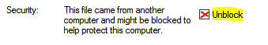
Download and install the sample app
Connect to your VM (instructions on sheet) and run all labs from the VM desktop
Download WTPLearningModules.zip (shortcut on desktop)
IMPORTANT: read the ReadMeFirst and unblock the inner zip file
Right click on the zip file, select Properties, on the General tab check unblock ->
Open Introduction to WTP Application.docx
Clink on the install link (http://aka.ms/deploywtpappold)
Fill in required parameters in the deployment template that opens in the Azure portal
Resource Group: ‘’wingtip-<USER>” e.g. “wingtip-bg1”
User: “<USER>” e.g. “bg1” short identifier to ensure resources names are unique
Location: “West US” | “South Central US” | “East US” | “South East Asia” | “North Europe”
Use a new resource group and user each time you install
When finished, delete the resource group. It’s quick and easy to re-install.
Notes:
Deleting the RG deletes all the resources and stops Azure billing
If you screw up during any of the workshops, easy to redeploy the app with a new resource group and user (inits2, inits3…)

Slide 18
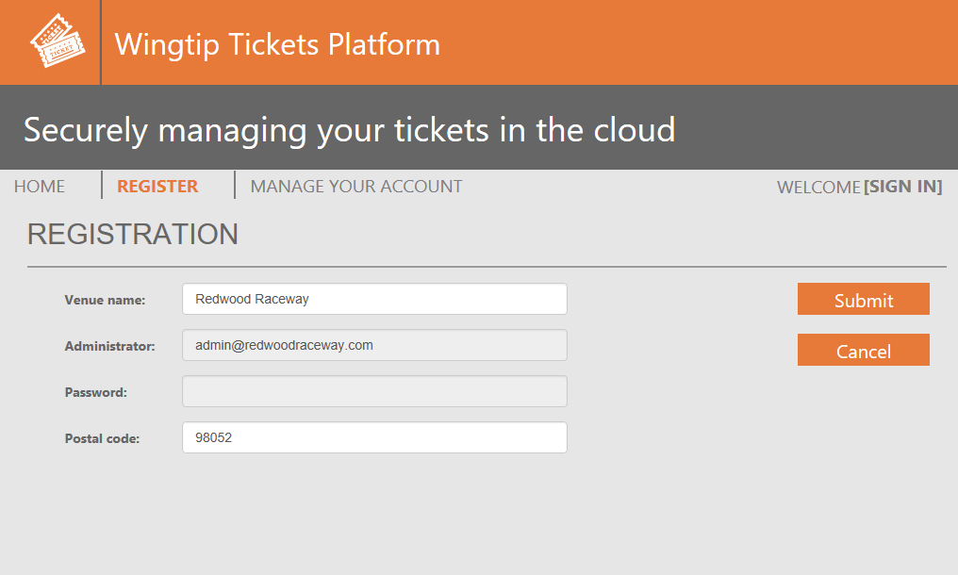
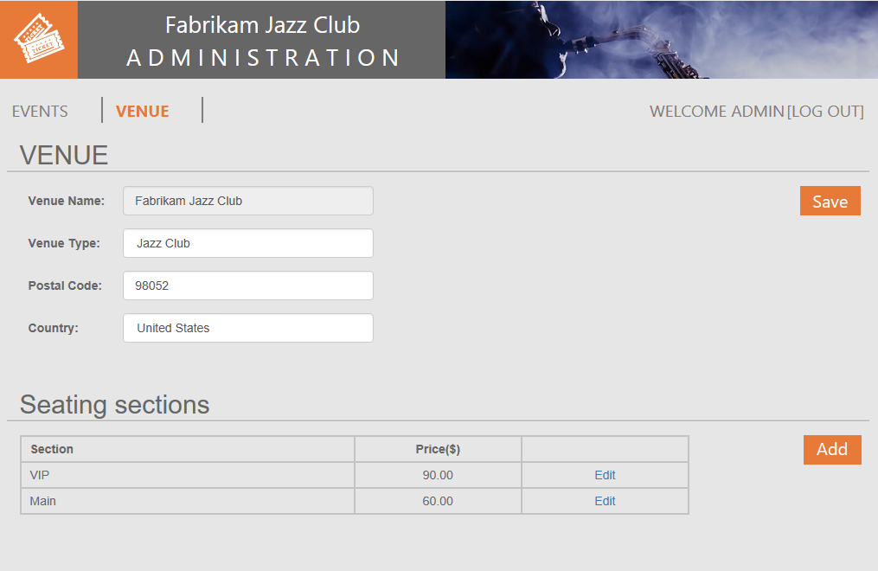
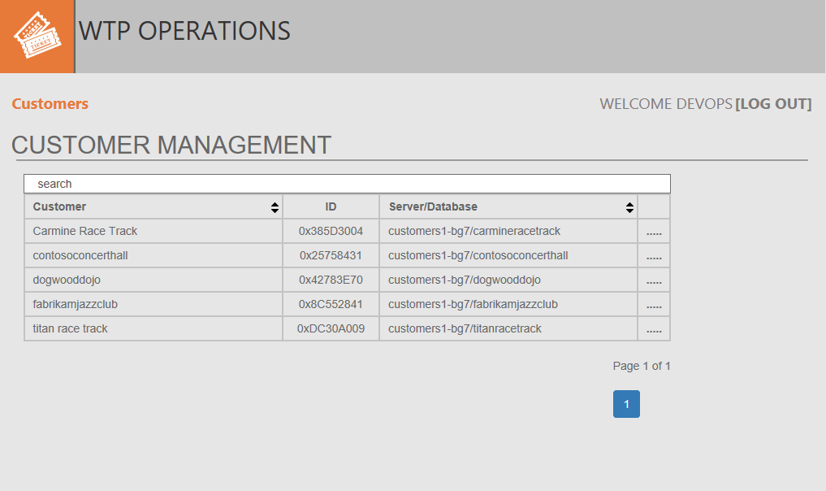
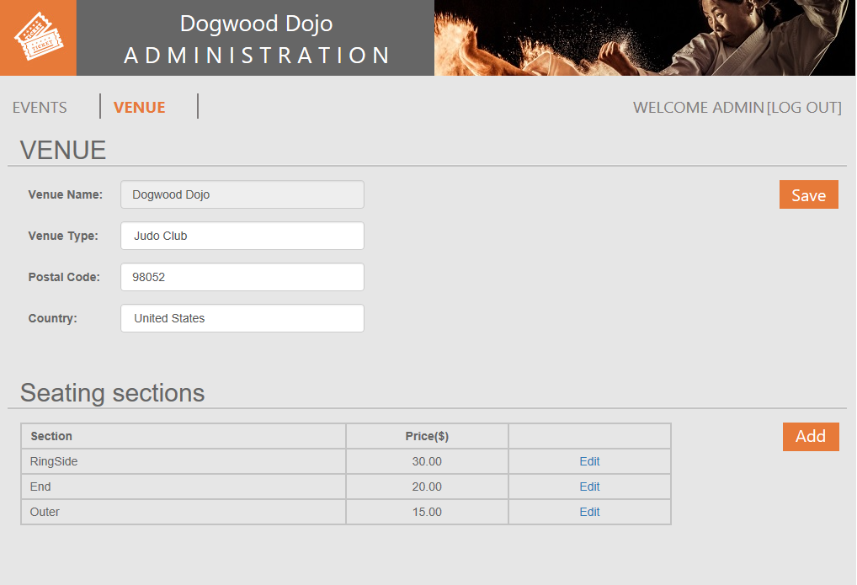
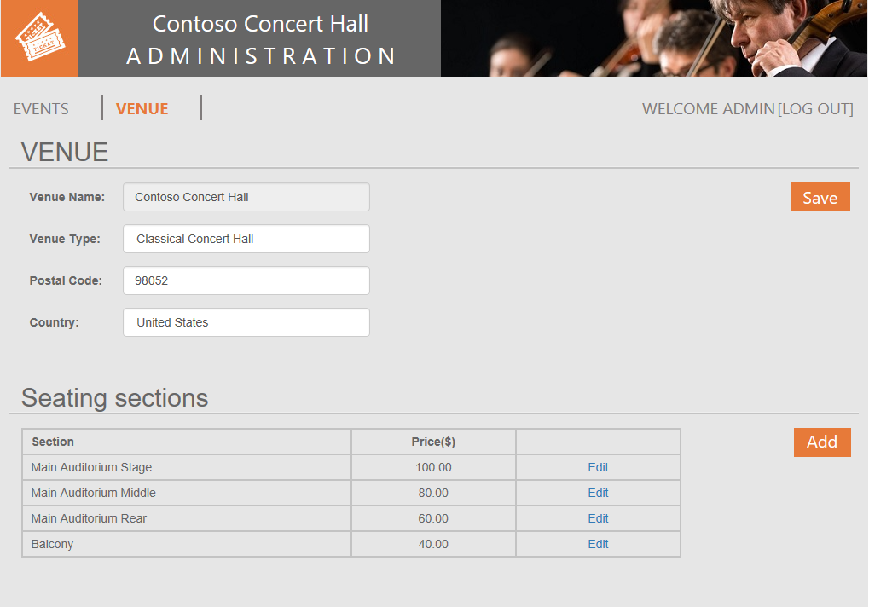
Wingtip Tickets Platform – 4 scenarios
Venue sign up
[venue owner]
Venue configuration, add events, set prices
[venue admin]
Browse events, buy tickets
[venue customers]
Manage venues
[WTP Devops]
Notes:
The application is built using a database-per-tenant
In addition to events, tickets, venues the database contains tenant configuration information, including tenant name, the venue type – concert/jazz/sports etc. which determines which image is shown

Slide 19
Exploring the Wingtip Tickets Platform (WTP)
Initialize the catalog after installing
Open the Demo Assistant app http://demo.wtp.<USER>.trafficmanager.net
Click Setup
Create a new tenant and then start the load generator as it takes a few minutes for the load to become apparent
Open …\Learning Modules\UserConfig.psm1 in PowerShell ISE, update resource group and user
Open …\Learning Modules\Utilities\Demo-LoadGenerator.ps1 in PowerShell ISE, press F5 to run
Follow the remainder of the guide…
Use the launcher in the demo Assistant App to explore the app (use ctrl-click to open links…)
Use the Azure portal to review the architecture (https://portal.azure.com)
Use SSMS to look at the databases
Notes:
The application is built using a database-per-tenant
In addition to events, tickets, venues the database contains tenant configuration information, including tenant name, the venue type – concert/jazz/sports etc. which determines which image is shown

Slide 20
WTP SaaS application architecture
register.wtp.<user>.trafficmanager.net
admin.wtp.<user>.trafficmanager.net/<venue>
events.wtp.<user>.trafficmanager.net/<venue>
operations.wtp.<user>.trafficmanager.net
demo.wtp.<user>.trafficmanager.net
Apps
catalog-<user>
customer
catalog
base tenantdb
job account
adhoc analytics
tenant analytics
tenant search
SQL DW
customers2-<user>
customers2-<user>
customers1-<user>
…
contoso concerthall
dogwood dojo
fabrikam jazzclub

Slide 21
exploring some of the patterns

Slide 22
Mapping tenants to databases
Tenant Onboarding
Application use
A. Customer signs up as new tenant
1. End user connects via a front end to the app
B. App provisions new tenant db
2. App looks up tenant in catalog via key
Apps
C. …registers tenant id, db name in catalog
3. …connects to correct tenant database
Tenant bacpac
Base TenantDB
SQL Database
Catalog
4. …on subsequent requests, uses cached database location
Tenant Catalog
Cust 1
Cust 2
Cust 3
Cust 4
Cust N
Elastic Data Client Library
Tenant Databases
Notes:
Manage tenant/database mapping and connections. SQL Database provides a client library used in the cloud service, plus a pro-forma schema for the catalog (referred to as a shard map), that together enable you to manage the tenant database mapping and to access and this efficiently at runtime.
Client library is used in the cloud service, and here is represented by the green bar
2 scenarios: onboarding a new tenant, normal application use
Onboarding
Can be automated as part of the cloud service application using API calls to the SQL Database service, optionally using ARM templates
Provisioning the database can include importing a bacpac and can be done using an ARM template (ARM manages retry)
If you use an ARM template you can populate the schema as part of deploying the database
Cloud service needs to register the database in the catalog once created
Application Use
The tenant signs in and the cloud service now uses the catalog to determine which database to connect to.
Cloud service may retrieve configuration data from the database to configure the experience for the user
The client layer

Slide 23
hands on
provisioning and cataloging
(single and batch)

Slide 24
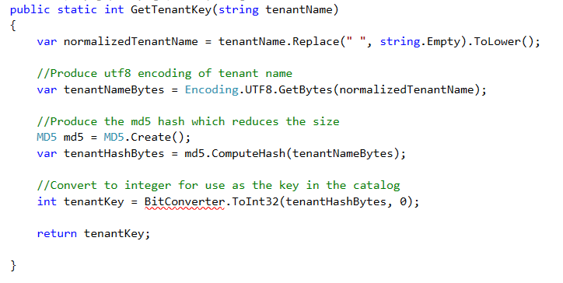
Dynamic data routing
Tenant name is parsed from the URL path and converted to sharding key
Other key types supported include byte[], GUID, date

Slide 25
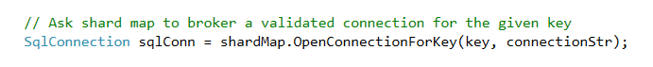
Dynamic data routing
The magic lies in one line of code…
Opens a connection to the tenant’s database based on the key
Replaces the standard open connection statement
Connection information is cached to speed up re-connection and avoid bottlenecking on catalog

Slide 26
Managing unpredictable tenant workloads
1. Provisioning service creates pool
2. …pre-provisions databases
3. As tenants register they are assigned databases
Apps
4. Service pre-provisions next pool and databases
5. Scale pool to handle more load/databases
SQL Database
Catalog
6. Move databases between pools to load-balance pools
7. Databases can be moved out if they become very active
pool1
pool2
pool3
Cust 4
Cust 17
Cust 1
Cust 2
Cust 3
Cust 10
Cust 11
Cust 12
Cust 13
Notes:
Managing the provisioning and placement of databases in pools is key to effectively managing resources and ensuring the solution is manageable for large numbers of tenants.
Create a new pool ready for new databases
Create new databases directly in the pool. As you pay only for the pool not the databases, its efficient to pre-create databases for tenants.
Reduces onboarding time,
Ensures databases are fully backed up before you start putting customer data in them.
Increase pool size (resources allocated to it) to support more databases or more activity
Load balance by moving databases between pools
Move database out of pool if it becomes more active and is more cost effective as a stand-alone db
All the pool and database creation and management actions can be invoked from the app allowing automated resource management

Slide 27
hands on
monitoring and alerting
elastic pool performance management
(generate ticket sales)

Slide 28
After running the service for some time…. WTP, listens to their customers…
Generally, they love the service, but…
Some customers complain that performance dips occasionally (noisy neighbors?)
Some customers complain they cannot sell tickets fast enough (performance capped?)
Some customers find that because they don’t host popular events they can’t justify the service cost.

Slide 29
Gather and analyze data to validate hypotheses and test improvements and experiments
Identify opportunities to improve customer experience and improve their business model
→ Increase perceived value in the delivered app
Increase service efficiency and optimize ISV business model
→ Improve quality of service, increase operating efficiency/reduce costs, monetize improvements

Slide 30
Unlock insights from vast amounts of tenant data
Apps
Catalog
Unlock operational and application insights
? ? ?
Cust 1
Cust 2
Cust 3
Cust 4
Cust N
Tenant Databases
Notes:
As a SaaS vendor there are many reasons to want to look across your set of tenant databases.
This viewpoint lets you learn about your customers and how they use your service.
To do this we need to distribute queries across all the databases
Elastic query provides a way to do this, enabling, fanout of queries to each database.
A head database is created and this is then mapped to remote
It uses the catalog to describe the scope of the query, and then creates a distributed

Slide 31






Ad-hoc query across tenant databases
Query all tenants as if they are in a single database
PowerBI
Apps
Query from any client
Database locations are retrieved from catalog
Elastic Query
Catalog
Adhoc Analytics
External tables project data from tenant dbs
Tenant Catalog
Cust 1
Cust 2
Cust 3
Cust 4
Cust N
Distributed query plan
Tenant Databases
Notes:
As a SaaS vendor there are many reasons to want to look across your set of tenant databases.
This viewpoint lets you learn about your customers and how they use your service.
To do this we need to distribute queries across all the databases
Elastic query provides a way to do this, enabling, fanout of queries to each database.
A head database is created and this is then mapped to remote
It uses the catalog to describe the scope of the query, and then creates a distributed

Slide 32
hands on
Ad-hoc analytics with Elastic Query

Slide 33
Extract tenant data into an analytics DB or DW
Unlock operational and application insights
PowerBI
Azure Portal
Apps
Query from any client
T-SQL
CREATE TABLE…
CREATE INDEX…
INSERT INTO…
SELECT * FROM…
T-SQL Job
SELECT * FROM…
Job Account
Catalog
Adhoc Analytics
Tenant Analytics
Tenant Catalog
SQL DB with ColumnStore or SQL DW
Cust 1
Cust 2
Cust 3
Cust 4
Cust N
Elastic Jobs
T-SQL
T-SQL
T-SQL
T-SQL
T-SQL
Tenant Databases
Notes:
As a SaaS vendor there are many reasons to want to look across your set of tenant databases.
This viewpoint lets you learn about your customers and how they use your service.
To do this we need to distribute queries across all the databases
Elastic query provides a way to do this, enabling, fanout of queries to each database.
A head database is created and this is then mapped to remote
It uses the catalog to describe the scope of the query, and then creates a distributed

Slide 34
hands on
extract and load data into an analytics store using Elastic Jobs

Slide 35
extract insights from tenant data using SQL Data Warehouse

Slide 36



Azure SQL Data Warehouse
A relational data warehouse-as-a-service, fully managed by Microsoft.
Industries first elastic cloud data warehouse with proven SQL Server capabilities.
Support your smallest to your largest data storage needs.
Elastic scale & performance
Market Leading Price & Performance
Powered by the Cloud
Azure
Azure
Get started in minutes
Integrated with Azure ML, PowerBI & ADF
Scales to petabytes of data
Massively Parallel Processing
Instant-on compute scales in seconds
Saas
Simple billing compute & storage
Pay for what you need, when you need it with dynamic pause
Azure
Office 365
Office 365
Public
Cloud
Notes:
The application is built using a database-per-tenant
In addition to events, tickets, venues the database contains tenant configuration information, including tenant name, the venue type – concert/jazz/sports etc. which determines which image is shown

Slide 37
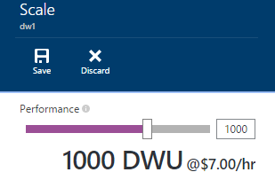
Elastic Scale
Spin up for heavy workloads, cycle down for daily activity
Buy time to insight based on what you need, when you need it
Choose the combo of compute and storage that meets your needs
Notes:
The application is built using a database-per-tenant
In addition to events, tickets, venues the database contains tenant configuration information, including tenant name, the venue type – concert/jazz/sports etc. which determines which image is shown

Slide 38
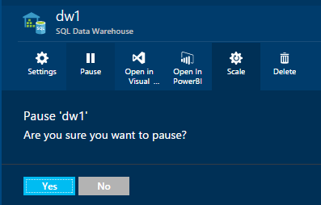
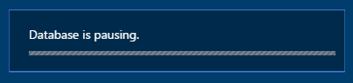
Pause
Data remains in place – no reloading / restoring of data
When paused, cloud-scale storage is min cost
Automate via PowerShell/REST API
$$$$
Notes:
The application is built using a database-per-tenant
In addition to events, tickets, venues the database contains tenant configuration information, including tenant name, the venue type – concert/jazz/sports etc. which determines which image is shown

Slide 39
SQL DW Fundamentals
Application or User connection
Control – “The Brain”
Connection and tool endpoint. Coordinates storage/compute activity.
Control
Engine
Data Loading
(ADF, SSIS, REST, OLE, ODBC, ADF, AZCopy, PowerShell)
DMS
SQL DB
Compute – “The Brawn”
Handles query processing, ability to scale up/down
Compute
Compute
Compute
Compute
DMS
DMS
DMS
DMS
SQL DB
SQL DB
SQL DB
SQL DB
Dist_DB_1
Dist_DB_2
Dist_DB_15
Dist_DB_16
Dist_DB_17
Dist_DB_30
Dist_DB_31
Dist_DB_32
Dist_DB_45
Dist_DB_46
Dist_DB_47
Dist_DB_60
Data Movement Services
Coordinates data movement between nodes/storage
…
…
…
…
Storage
Database data and log files are stored on WASB separate from compute
Blob storage [WASB(S)]

Slide 40


Distributed Queries
Result
Query
Control
Compute
Storage

Slide 41
Round Robin Distribution
01
02
03
04
05
06
07
08
09
10
11
12
13
14
15
16
17
18
19
20
21
22
23
24
25
26
27
28
29
30
31
32
33
34
35
36
37
38
39
40
41
42
43
44
45
46
47
48
49
50
51
52
53
54
55
56
57
58
59
60

Slide 42
Hash Distribution
HASH ( )
01
N
03
01
02
01
02
03
04
05
06
07
08
09
10
11
12
13
14
15
16
17
18
19
20
21
22
23
24
25
26
27
28
29
30
31
32
33
34
35
36
37
38
39
40
41
42
43
44
45
46
47
48
49
50
51
52
53
54
55
56
57
58
59
60

Slide 43
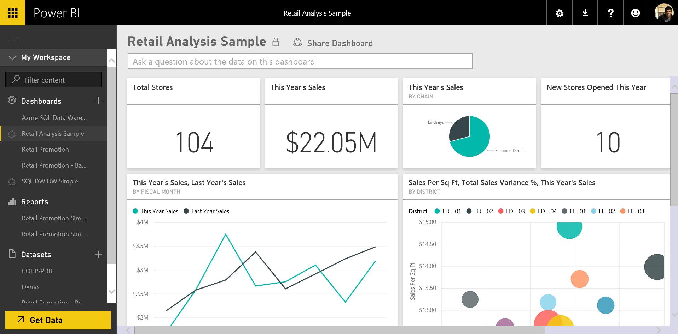

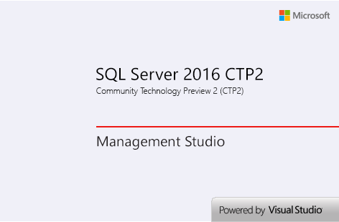
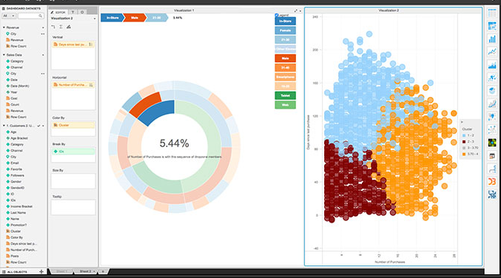

SQL DW Common Usage Pattern
HUB and Spoke Model
Azure SQL DB or SSAS
Source Systems
Azure Storage Blob
ADF
SQL DW
Event Hub
(JSON)
Or
On-Premise Systems
Store data files
Load transformed data to SQL DW
Hub
32 Concurrent Queries
Spokes
Interactive queries or Reporting
Notes:
Karan
Joins cant across spokes

Slide 44
hands on
analytics leveraging SQL Data Warehouse

Slide 45
Insight
Opportunity
Many venues host events that don’t sell out and which are less profitable.
Can WTP do something to increase sales and revenue for underperforming venues?
Many people attend events at multiple venues in the same area.
Can WTP help people find events hosted by WTP venues in the their area and boost traffic?
A small number of venues account for a large % of overall ticket sales, with large events that sellout rapidly. High rates of sale from these customers can impact the performance experience of other venues.
Could WTP introduce a tiered service with different SLAs, separating venues with different performance requirements?

Slide 46
Insight
Opportunity
Many venues host events that don’t sell out and which are less profitable.
Can WTP do something to increase sales and revenue for underperforming venues?
Develop a system that predicts the likelihood of events selling out and guides the event administrator to offer discounts that maximize revenue

Slide 47
Use Machine Learning to predict and impact the future

Slide 48
What is Machine Learning
Computer systems that become smarter with experience
Experience = Historic Data + Human Input

Slide 49

Azure Machine Learning
Powerful predictive analytics in Azure
Machine Learning
ML Algorithms are best of breed and embrace OSS
MS + R + Python + BYOA
ML Studio for productive development
Faster experiments results in faster improvements
Visual Workflows & ML Experiments at Cloud Scale
ML Operationalization to remove deployment friction
Build entire ML Apps & Deploy as Cloud APIs
Data
Machine Learning (Algorithms)
Operationalization
Data
Operationalization

Slide 50

Traditional Apps
ML Powered Apps
Program logic based on static rules
Actions are predefined
Limited adaptation to change in patterns of data
Program logic based on learnings from historic data
Makes predictions and improves with experience
Leverages cloud-hosted APIs

Slide 51
Data Science Process Step-by-Step
Plan
Acquire Data
Explore
Understand business problem and define objectives
Ingest, explore, understand and update your data
Develop deep data understanding to glean patterns
1
2
3
Featurize
Model
Deploy & Consume
Create insightful features to facilitate model building
Build and evaluate predictive models and select best model
Operationalize model and develop apps to consume published web services
4
5
6
https://azure.microsoft.com/en-us/documentation/learning-paths/data-science-process

Slide 52
Data Science Process Step-by-Step
Plan
Acquire Data
Explore
Understand business problem and define objectives
Ingest, explore, understand and update your data
Develop deep data understanding to glean patterns
1
2
3
Featurize
Model
Deploy & Consume
Create insightful features to facilitate model building
Build and evaluate predictive models and select best model
Operationalize model and develop apps to consume published web services
4
5
6
https://azure.microsoft.com/en-us/documentation/learning-paths/data-science-process

Slide 53

Exploratory Questions
Ask the right question
Plan
pIN
Sharp Questions
Can’t be answered with a name or number
Can be answered with a name or number
What can my data tell me about by business?
What should I do?
How many theater tickets will I sell in Seattle during the third quarter?
Which elevator in which theater will fail first?

Slide 54
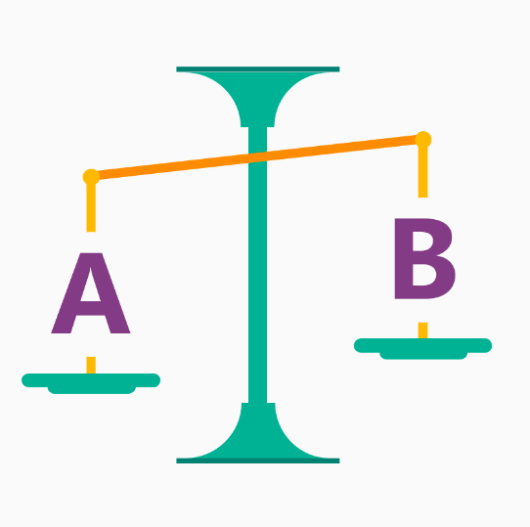


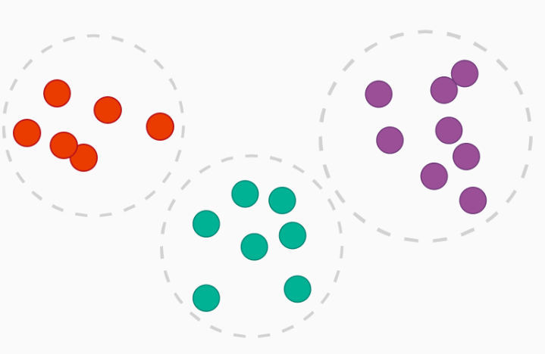

Pick an algorithm (Know what question you want to answer!)
Model
Classification
Is it A or B?
Which of these two events is most interesting to our customers?
Will a particular event sell out?
Anomaly
Is it weird or unexpected?
This event sold out in an hour, is this sales cycle normal?
Regression
How much? How many?
How much discount do we need to provide to sell out a given event?
What will the May sales be?
Clustering
How is it organized?
What types of customers like the same types of events?
Mon
Tue
?
78

Slide 55


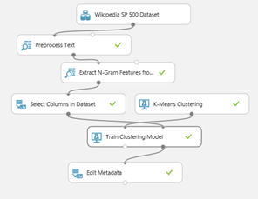



Azure Machine Learning
Data
ML Studio
APIs
Client
1244667453241233242343464573478076845632412323434547568a426436070433243565670768567452312323434546567879674534423232443545665776876
Ingest data from blobs, tables, HDFS or relational database
Train and model in integrated, browser based development environment
Operationalize by creating, callable web service APIs
Embed into your App

Slide 56
Predict ticket sales based on past performance
Build a model to predict ticket sales for a given event - based on historic sales, featured against venue type, time and day of week of event, location, advertising media, etc.
Operationalize it and publish it as a web service embedding it into our application
To empower our customers (venue owners) to seamlessly increase sales and revenue by proactively identifying potential underperforming venues or events

Slide 57
Provide interactive analytics in your application with Power BI for embedded analytics

Slide 58

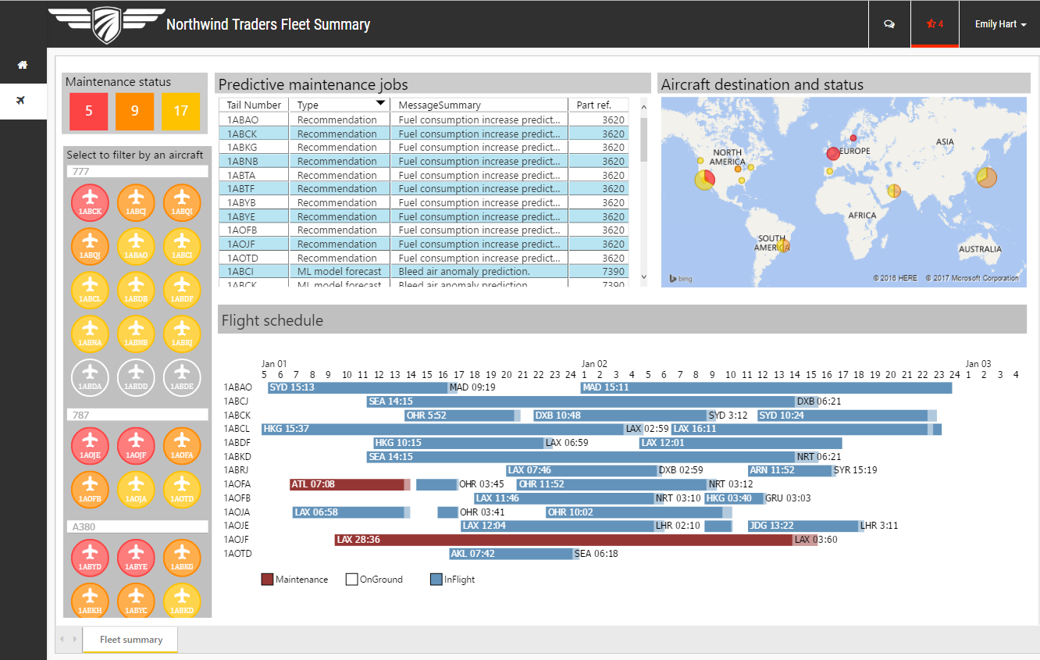
Nearly everyone engages with apps
Yet fewer than 22% of employees have access to analytical insights
http://biscorecard.typepad.com/biscorecard/bi-strategies//
Notes:
But research shows less than 22% of the employees have access to analytics software and tools. In order to achieve your digital transformation goal every software , operational software especially, needs to disseminate analytical insights inside the enterprise. This will enable everyone to take intelligent action in the context of the business process operation.

Slide 59
Many apps have reporting capabilities
Providing contextual insights where and when users need them is challenging
010001001010 110101010010 101011010101
Dispersed and complex data
Device-agnostic consumption
Shrinking attention spans

Slide 60

What if your app could put the power of analytics everywhere decisions are made?
Modern apps with data visualization built-in have the power to inform decisions in context— for any user, on any device

Slide 61
Consider your options
Build it
You’re savvy, but building and maintaining your app is complex enough
Buy the best fit solution
A fully-managed embedded BI platform, that’s built for SaaS, won’t hold you back

Slide 62
Power BI for embedded analytics Apps energized with analytics
DATA
INSIGHTS
ACTION
Get started quickly
Live Reports & Dashboards
Cloud
Natural Language Query
Custom Visualizations
Apps
Power BI
On-premises
Open & extensible
Notes:
Open and extensible around the cloud

Slide 63
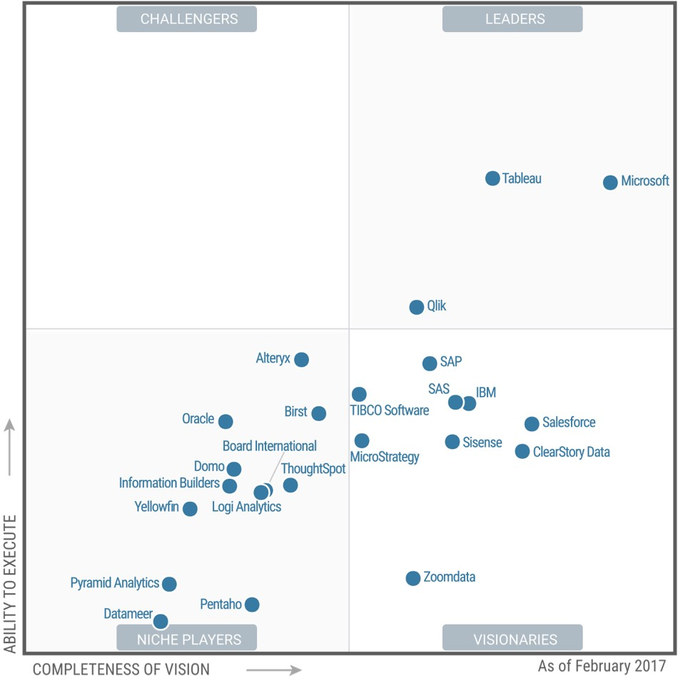

FEBRUARY 2017
A Leader in the Magic Quadrant for BI & Analytics*
*Gartner “Magic Quadrant for Business Intelligence and Analytics Platforms,” by Rita L. Sallam, Cindi Howson, Carlie J. Idoine, Thomas W. Oestreich, James Laurence Richardson, and Joao Tapadinhas February 16, 2017
This graphic was published by Gartner, Inc. as part of a larger research document and should be evaluated in the context of the entire document. The Gartner document is available upon request from Microsoft. Gartner does not endorse any vendor, product or service depicted in its research publications, and does not advise technology users to select only those vendors with the highest ratings or other designation. Gartner research publications consist of the opinions of Gartner's research organization and should not be construed as statements of fact. Gartner disclaims all warranties, expressed or implied, with respect to this research, including any warranties of merchantability or fitness for a particular purpose.

Slide 64

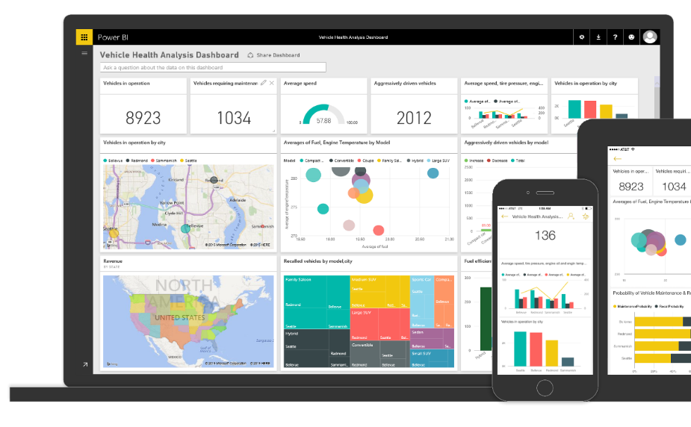
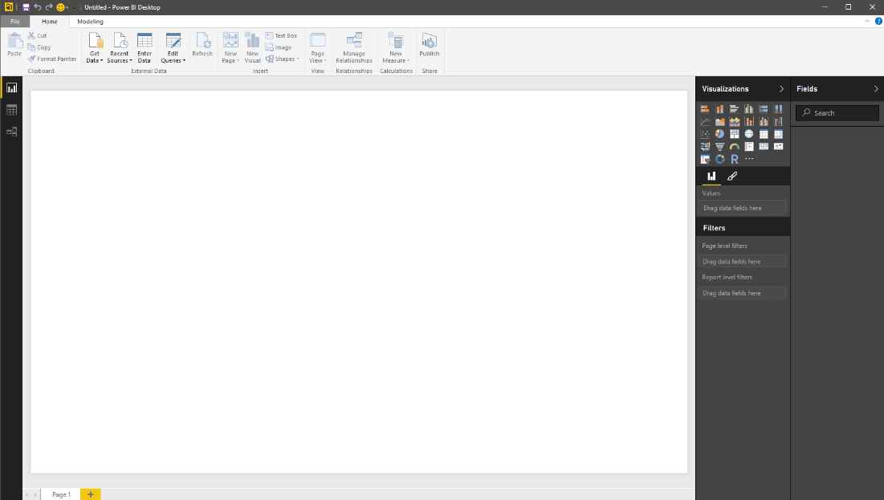
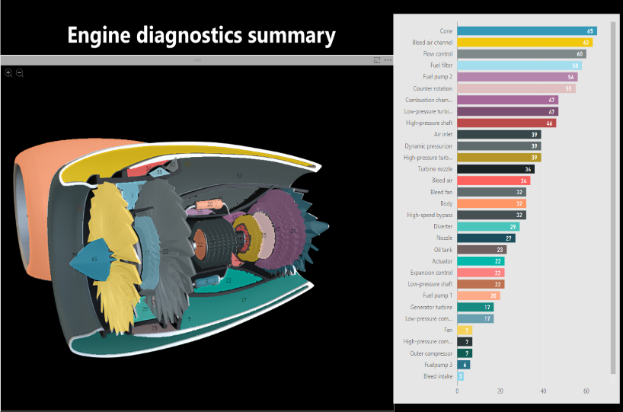
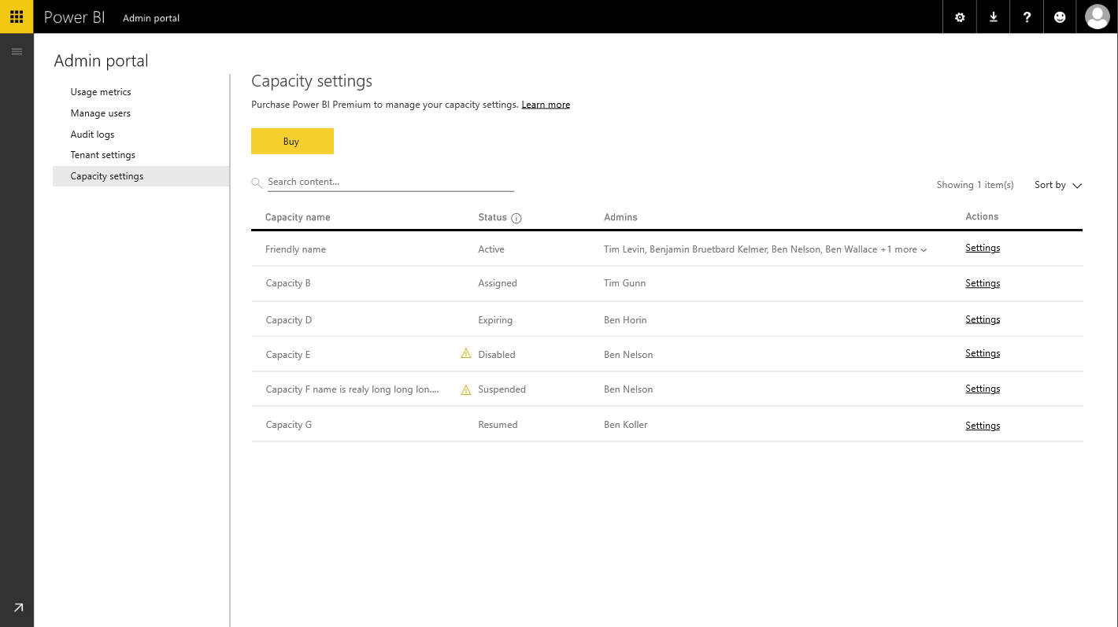
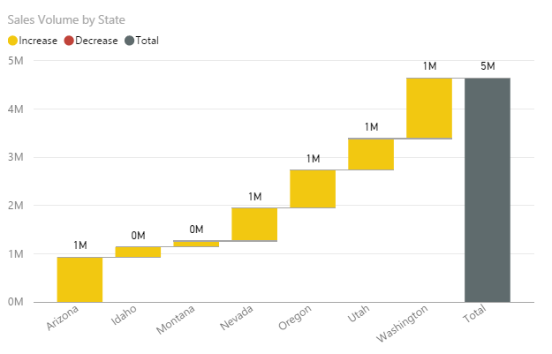
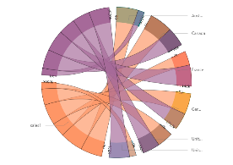
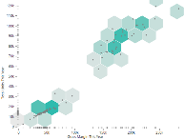
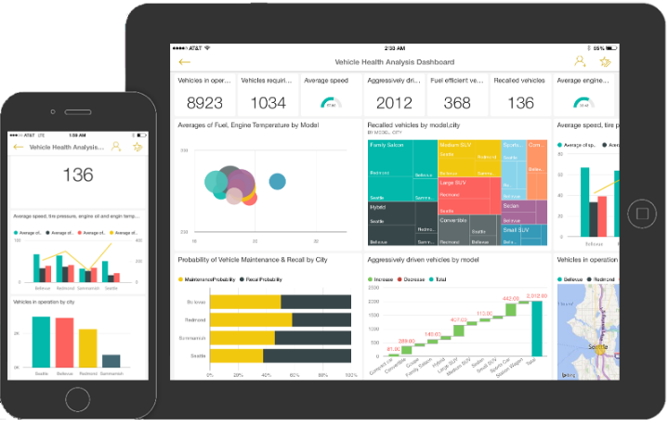
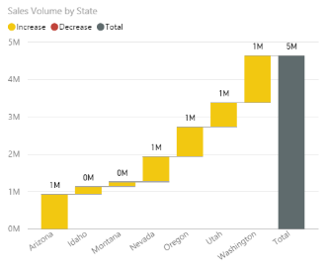

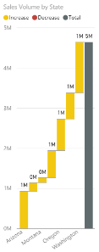
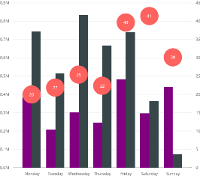
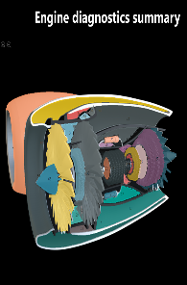
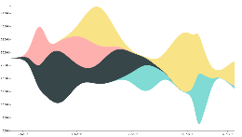
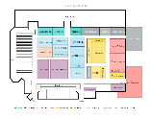

Bring data to life inside your app
Create compelling interactive reports
Provision quickly and manage with ease
Embed easily for faster time to value

Slide 65

Create compelling interactive reports that are always up to date
Author interactive reports without writing any code for fast time-to-value
Choose modern visualizations out-of-the-box or customize without building them from scratch
Keep reports up to date with live connectivity, schedule refresh and streaming data
Create
Provision
Embed

Slide 66
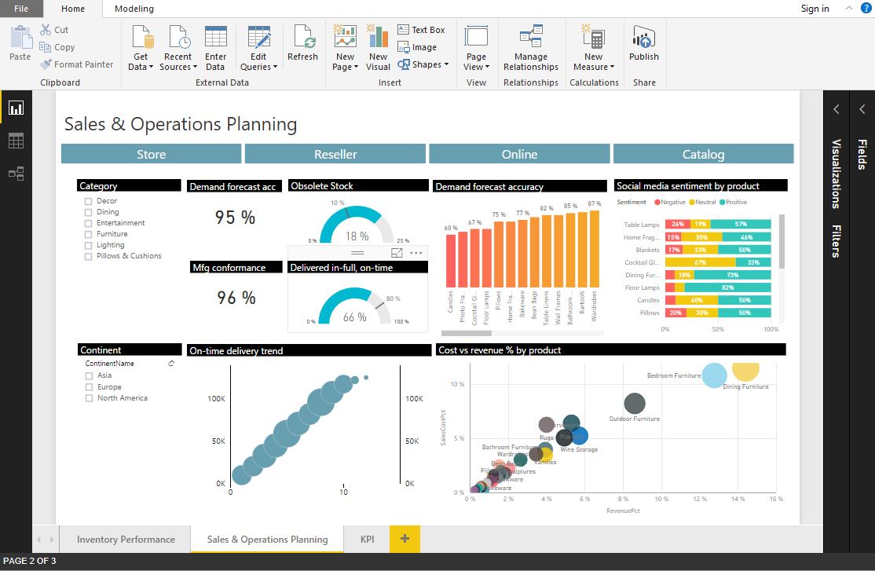
Easily author interactive reports for free in Power BI Desktop
Shape data into the format and structure you need
Produce rich data models using formulas and relationships
Explore data through a freeform, drag-and-drop canvas
Publish interactive visualizations to your app
Create
Provision
Embed
Notes:
Change alignment

Slide 67

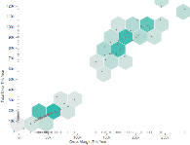



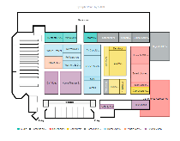
The right visualization for your app with Custom Visuals
Any visualization you can imagine not limited to “what’s-in-the-box”
Download visuals from the Power BI community-authored visuals gallery and Office store
Create
Provision
Embed

Slide 68

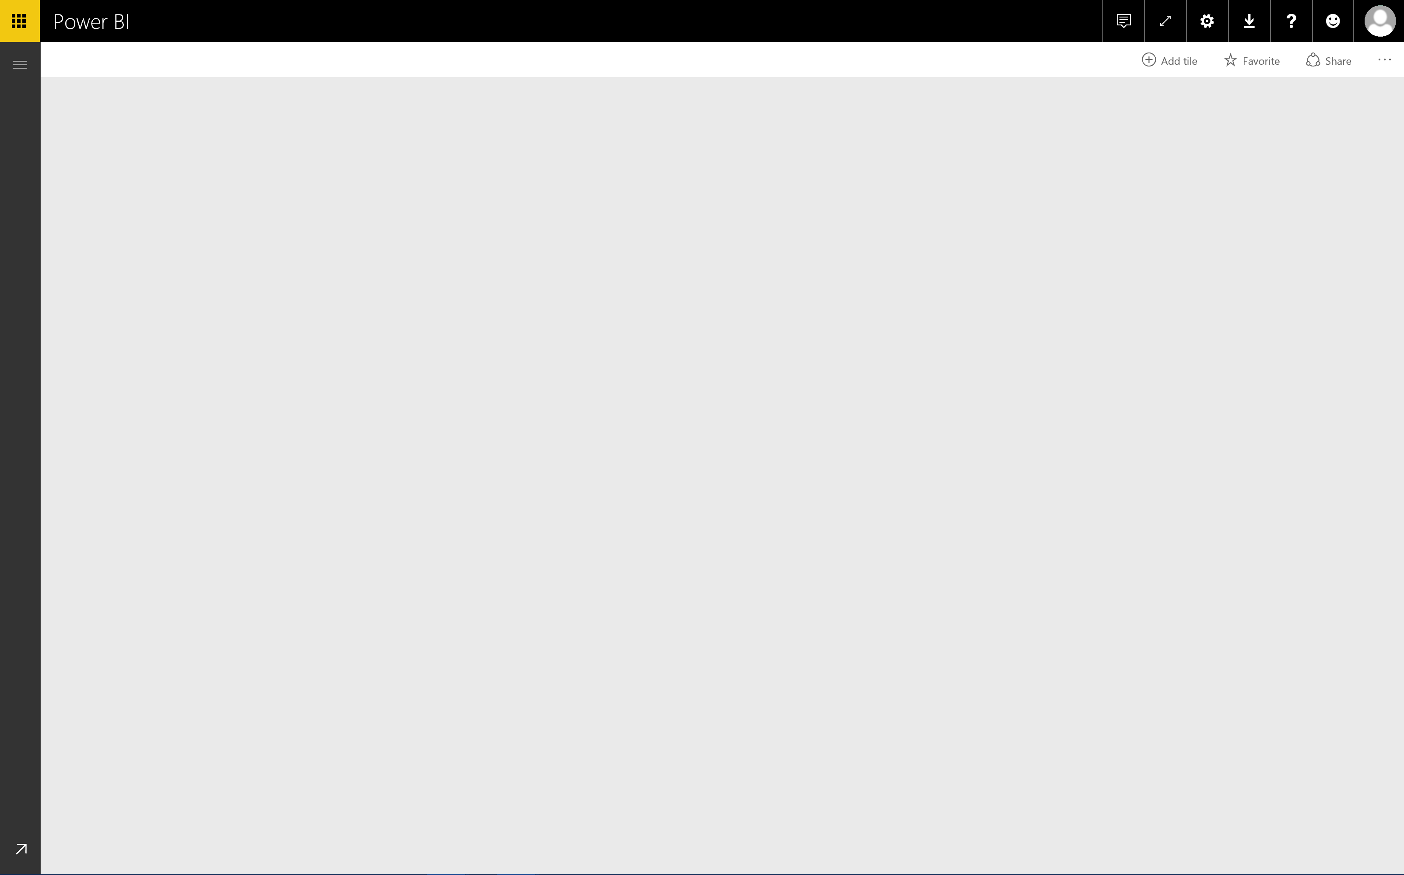
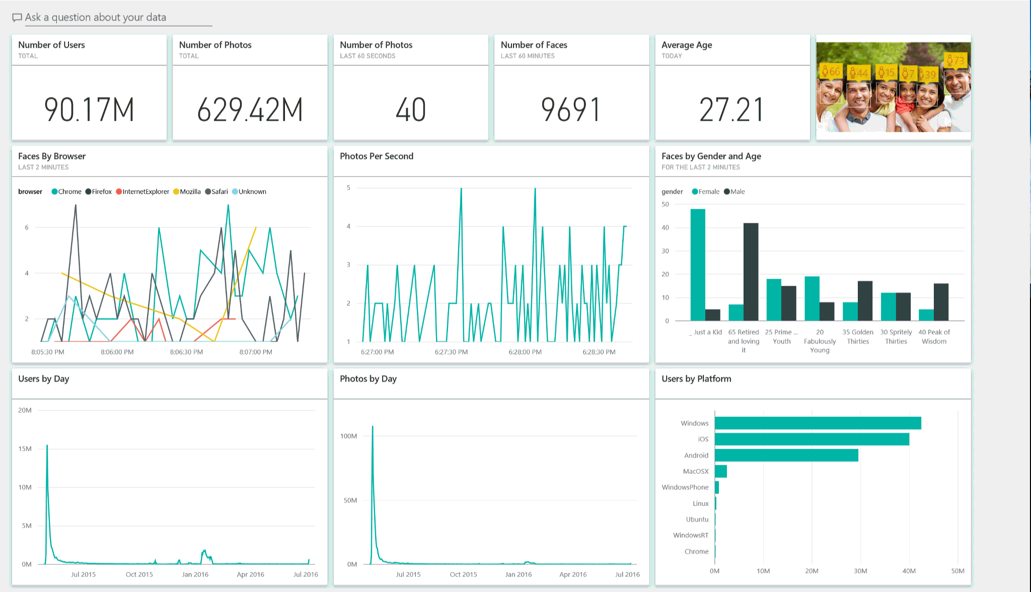
Keep the data in your app up to date
Connect directly to data sources using Direct Query
Create cached models with scheduled refresh
Track your data in real-time with support for streaming data
Create
Provision
Embed

Slide 69

Provision automatically and deploy at scale
Automate provisioning with Power BI APIs
Easily scale up while keeping costs under control with Power BI Premium dedicated capacity
Dedicated
resources
in the cloud
Greater scale and performance
Power BI Premium
Flexibility to license by capacity
Create
Provision
Embed

Slide 70

Embed reports easily—for any device and faster time-to-value
Easily embed interactive reports and dashboards in your app using REST APIs and the Power BI SDK
Make intelligent actions the norm with the bidirectional JavaScript API
Provide friction-free authentication and authorization experiences
Create
Provision
Embed

Slide 71
Embedded analytics for all users
External
Internal
Packaged applications
Line of Business applications
SaaS applications
SharePoint Online
External portals
Internal portals

Slide 72
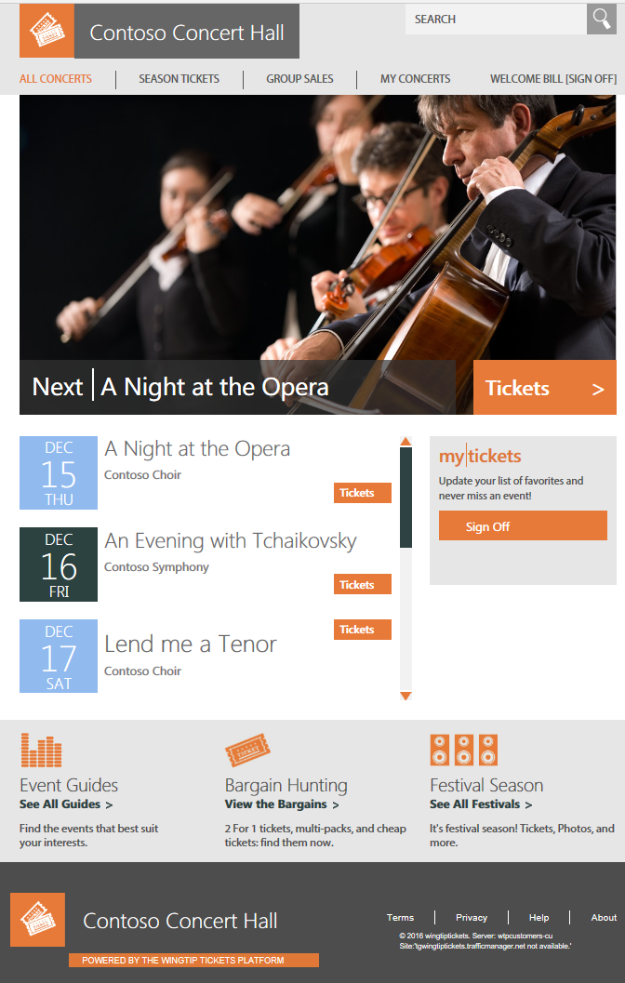

Contoso Concert Hall
ADMINISTRATION
Contoso Concert Hall
ADMINISTRATION
Contoso Concert Hall
ADMINISTRATION
EVENTS | VENUE
WELCOME SARAH [LOG OUT]
EVENTS | VENUE
WELCOME SARAH [LOG OUT]
EVENTS | VENUE
WELCOME ADMIN [SIGN OFF]
WELCOME ADMIN [SIGN OFF]
WELCOME SARAH [LOG OUT]
WELCOME ADMIN [SIGN OFF]
EVENT DETAILS
EVENT DETAILS
EVENT DETAILS
Event name:
Save
Event name:
Save
Event name:
Save
Event subtitle:
Event subtitle:
Event subtitle:
Delete
Delete
Delete
Event date:
/
/
Event date:
/
/
Event date:
/
/
Cancel
Cancel
mm
dd
yyyy
Cancel
mm
dd
yyyy
mm
dd
yyyy
Start time:
Start time:
Start time:
8:00
PM
8:00
PM
8:00
PM
Ticket Prices
Ticket Sales Analysis
Ticket Prices
Ticket Sales Analysis
Ticket Prices
Ticket Sales Analysis
71%
+ $6,700
71%
+ $6,700
Sellout probability:
Revenue opportunity :
Sellout probability:
Revenue opportunity :
Section | Initial Price | Discount | Current Price
Main floor | 80 | 10 | 72
Balcony | 50 | 10 | 45
Pit | 40 | 20 | 32
Reset
Ticket Sales
Revenue
100
Discount
Ticket Sales
Revenue
100
Discount
All sections
30%
All sections
30%
<section 1>
20%
<section 1>
20%
<section 2>
75
10%
<section 2>
75
10%
<section 3>
0%
<section 3>
0%
<section 4>
50
<section 4>
50
<section 5>
Apply
<section 5>
Apply
<section 6>
25
<section 6>
25
<section 7>
Avg. discount
<section 7>
Avg. discount
<section 8>
<section 8>
…
60
50
40
30
20
10
0
0
14%
…
60
50
40
30
20
10
0
0
16%
…
Days to Event
…
Days to Event
…
…
LEARN HOW TO BUILD A SAAS APP ON SQL DATABASE
Running on Azure SQL Database, ©2017 Microsoft server: <tenant-server>.database.windows.net
database: <tenant-db-name> tenant id: <tenant-raw-id>
LEARN HOW TO BUILD A SAAS APP ON SQL DATABASE
Running on Azure SQL Database, ©2017 Microsoft server: <tenant-server>.database.windows.net
database: <tenant-db-name> tenant id: <tenant-raw-id>
LEARN HOW TO BUILD A SAAS APP ON SQL DATABASE
Running on Azure SQL Database, ©2017 Microsoft server: <tenant-server>.database.windows.net
database: <tenant-db-name> tenant id: <tenant-raw-id>

Slide 73
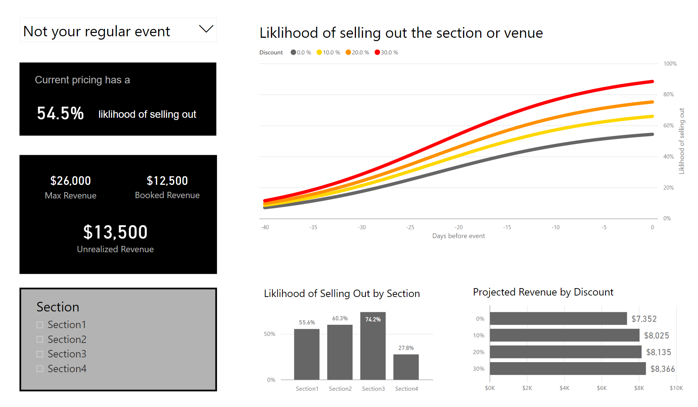

Slide 74
Demo: Complete application

Slide 75
Typical application SaaS application
Application User
Application UI/Permission Logic
Application Driven Row Level Security
Application
Each app drives specific value for users
Analytics is most valued when integrated into the application workflow
UI
Workflow
Analytics
Application Storage
Cache
Query
Your data
Your users

Slide 76
Data Pipeline
Application User
Application UI/Permission Logic
Application Driven Row Level Security
Application
How to get data into Power BI Embedded in a typical application
UI
Workflow
Analytics
Application Storage
Cache
Query
Your data
Your users

Slide 77
Standard BI Pipeline
Most ISV’s don’t have a data warehouse
It’s critical to a successful project
Abstract raw sources of data through a consistent store
Optimized for reporting = Faster queries
Less load on transactional store (ODS)
App’s Operational Store
Data Warehouse for Reporting
Power BI Embedded Report

Slide 78
Data warehouse best practices
Use a star schema
Column store index on fact table
Single column joins
Use integers for joins (not text strings)
Don’t have many levels of relationships (avoid snowflake schemas)
Use ETL to load data and keep it consistent across application Operational Store & Data Warehouse

Slide 79
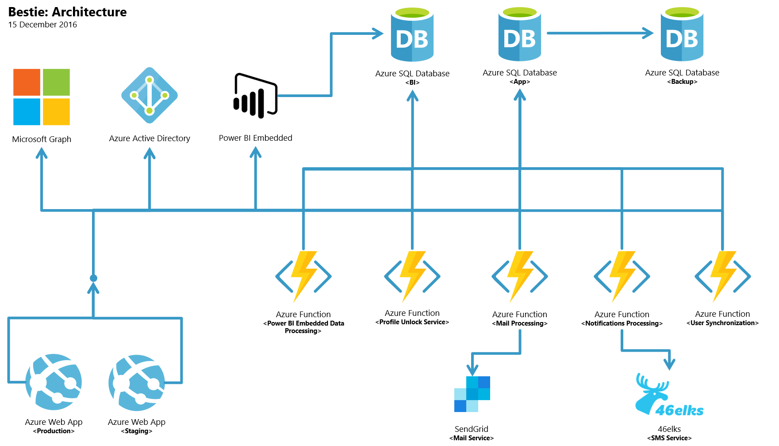
Example Data Pipeline Flow
2
1
1
Operational Data Store (ODS)
2
Data Warehouse (DW)
3
3
ETL* to both ODS and DW
Source: https://microsoft.github.io/techcasestudies/azure%20app%20service/power%20bi%20embedded/2017/01/09/Kompis-Sverige.html
*ETL = Extract Transform Load

Slide 80
Provisioning the report
Application User
Application UI/Permission Logic
Application Driven Row Level Security
Application
How to upload a report to Power BI Embedded
UI
Workflow
Analytics
Application Storage
Cache
Query
Your data
Your users

Slide 81
Provisioning a report
Design report in Power BI Desktop
Use APIs to publish it to a workspace
Call Import API
Call Default.SetAllConnections API to set connection strings
Multi-tenant applications
Deploy copies of the report for each tenant
Allows different data source connections for each report

Slide 82
Allowing users to view the report
Application User
Application UI/Permission Logic
Application Driven Row Level Security
Application
How to grant access to the report using AppTokens
UI
Workflow
Analytics
Application Storage
Cache
Query
Your data
Your users

Slide 83
Authorizing access with App Tokens
Your application authenticates users
You own and manage users
You own and manage user permissions
Your application issues tokens that authorize access to Power BI reports
Tokens are bearer tokens
The token your application issues determines:
What can be accessed
How long it can be accessed
What data can be seen by the user

Slide 84
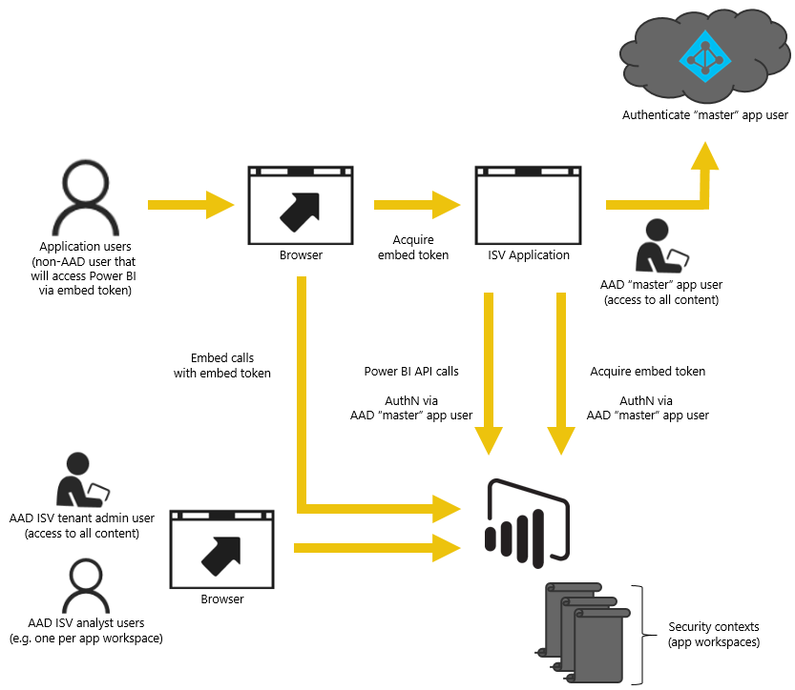
Token Authentication Explained

Slide 85
In-context analytics
Application User
Application UI/Permission Logic
Application Driven Row Level Security
Application
How to integrate reports into your application workflows
UI
Workflow
Analytics
Application Storage
Cache
Query
Your data
Your users

Slide 86
The Power BI JavaScript API drives an in-context analytics workflow
User navigates within the app
App shows a report filtered to a specific item
User interacts with data in the report
App reacts to data selection and shows additional options
User clicks application UI to perform an action

Slide 87
The Power BI Embedded API surface
Power BI JavaScript API
Provides bidirectional communication between Power BI reports and your app
Enables easier integration of reports and reporting functionality
Enables programmatic interaction
Embed a specific report
Page navigation
Load a default report page
Edit or Create reports
Enable/disable the filter pane
Filter reports
React to events, including print and reload
Handle data selection events
Enter/Exit full screen mode

Slide 88
hands on
Exercise
https://microsoft.github.io/PowerBI-JavaScript/demo/

Slide 89
Multi-tenant applications
Application User
Application UI/Permission Logic
Application Driven Row Level Security
Application
How to secure and architect applications for SaaS multi-tenant scenarios
How to secure data access between different users
UI
Workflow
Analytics
Application Storage
Cache
Query
Your data
Your users

Slide 90
Multi-tenant applications
Data security across tenants
Isolate data across tenants:
Row Level Security
Separate data warehouses
Use many Workspace Collections
Distributed geographically
Distributed by tenant
Use many workspaces
Distributed by tenant

Slide 91
How row-level security works through predicates applied at runtime
Report
+
Token
=
Query + Predicate
Defines Roles
Roles define predicates
Role: Company
Predicate: [Company] = “Fabrikam”
Role: Company
Predicate: [Company] = USERNAME()
Asserts Role Membership
Asserts Identity
roles: “Fabrikam”
roles: “Company”
username: “Fabrikam”
Query executes with correct scope
Select * FROM [Sales] WHERE [Company] = “Fabrikam”
SELECT * FROM [Sales] WHERE [Company] = “Fabrikam”
Ex.1
*
Ex. 2
* This example is for illustration purposes, the design of dynamic RLS will change once it is implemented.

Slide 92
Typical architecture SaaS application
Application User
Application UI/Permission Logic
Application Driven Row Level Security
Power BI Tenant (AAD)
Suitable for smaller deployments
Reports are standardized across customers, so app just uploads a copy of the report at provisioning time
Database schemas are identical, chosen to stay under Azure SQL size limits
Azure SQL maximum storage per database is 1TB (current P15 SKU)
PBI Group 1
Report 1 with RLS
Azure SQL for all tenants
ETL
Storage
Blob
Table Storage
Data Lake
Others…

Slide 93
Typical multi-tenant architecture SaaS application
Application User
Application UI/Permission Logic
Application Driven Row Level Security
PBI Tenant (AAD)
Isolates tenant data physically
Isolates user data within tenant with RLS
Uses groups and/or AAD tenants for isolation
Application logic routes users to their reporting resources
PBI Group 1
PBI Group N
Copy of Report 1 with RLS
Copy of Report 1 with RLS
Azure SQL for Tenant 1
Azure SQL for Tenant N
ETL
Storage
Blob
Table Storage
Data Lake
Others…

Slide 94
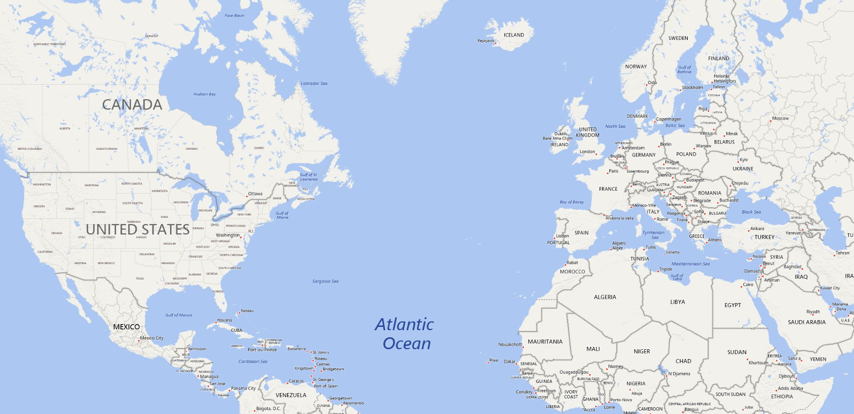
Typical multi-region architecture SaaS application
Application User
Application UI/Permission Logic
Application Driven Row Level Security
Supports global user base with region-specific compute and storage
Addresses network latency which can significantly affect customer’s perceived performance
Addresses regions that have law/compliance considerations
PBI Tenant (AAD) for
USA customers
PBI Tenant (AAD) for
European customers

Slide 95
End-user report customization
Application End Users can edit/create reports
Application author determines who can edit/create
Application author provides the data models
Application needs to handle the new content and ensure proper permission is provided
Application authors should remember to backup user customized content

Slide 96
Insight
Opportunity
Many people attend events at multiple venues in the same area.
Can WTP help people find events hosted by WTP venues in the their area and boost traffic?
Provide an ‘events hub’ with smart search that can find events of interest at nearby venues

Slide 97
Integrating Azure Search in database applications to increase customer value

Slide 98

Azure Search enables search over distributed tenant data
Azure Search
Apps
Tenant Catalog
Search
Catalog
Search database
Projects indexable data from all tenants
Cust 1
Cust 2
Cust 3
Cust N
Tenant Databases

Slide 99
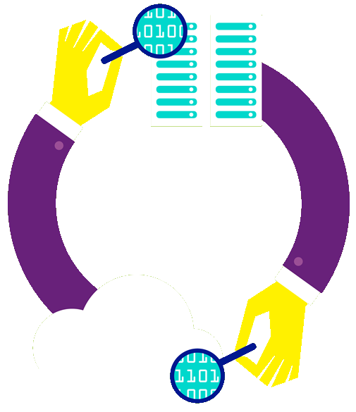
What is Azure Search?
A search-as-a-service solution allowing developers to incorporate great search experiences into applications without managing infrastructure or needing to become search experts.
“Simplify the Search Experience”

Slide 100
Why?
Developers look for PaaS services in Azure to achieve better results faster in their apps
Search is key to many categories of applications
Web search engines have set the bar high for search
Instant results, auto-complete, hit highlighting, great ranking, linguistics
Search is hard and rarely a core expertise area
Infrastructure standpoint: availability, durability, scale, operations
Functionality standpoint: ranking, language support, geo-spatial

Slide 101
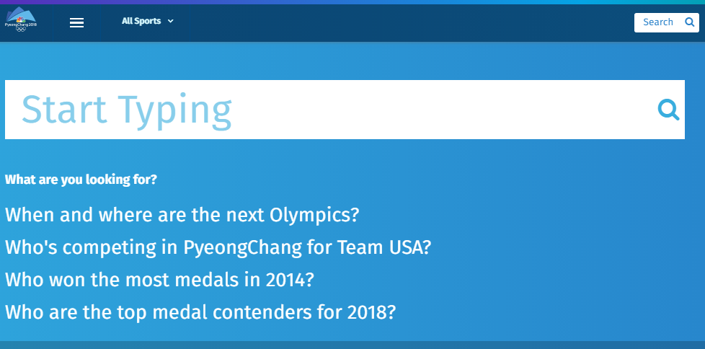
Type Ahead and Search Suggestions

Slide 102
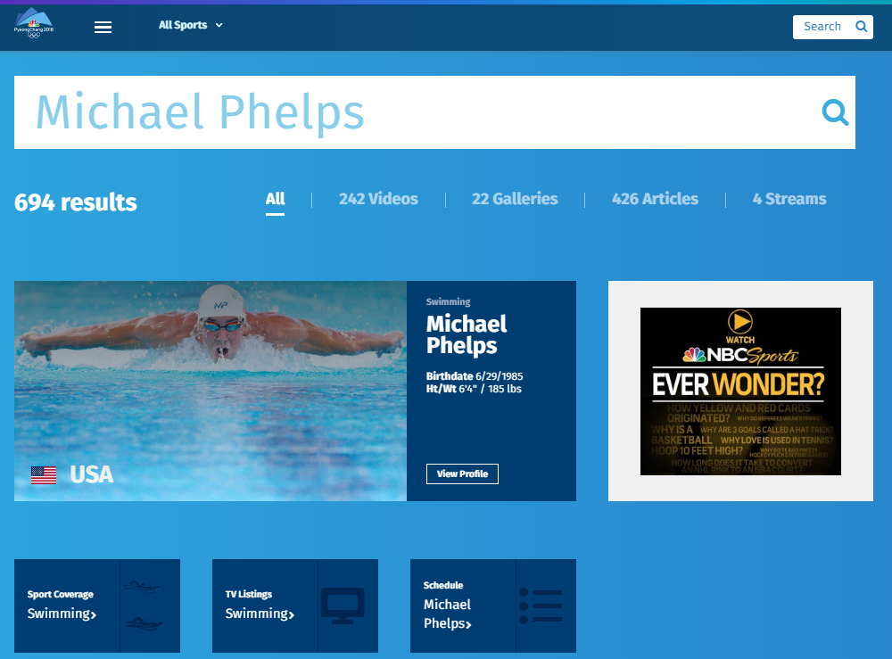
Facets
Tuning
Recommendations

Slide 103
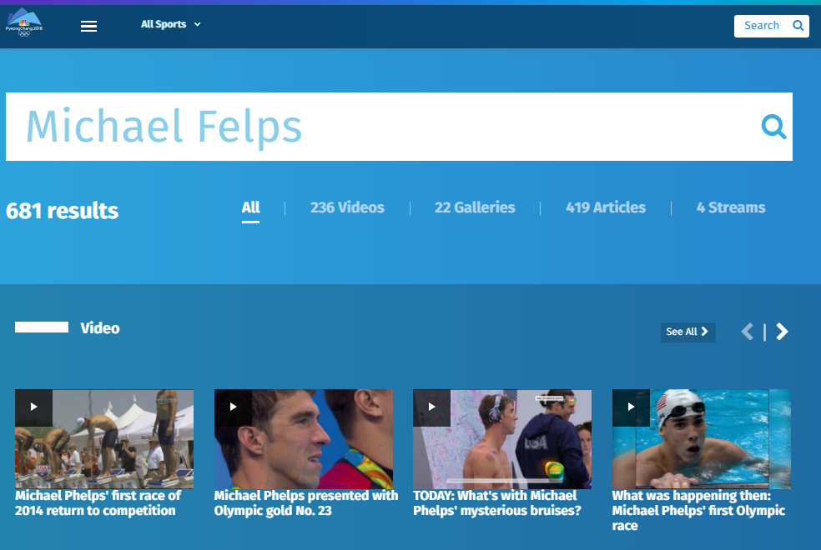
Spelling Mistakes

Slide 104
Typical Workflow
Provision service
Create index
Index data
Search

Slide 105
Demo
Liam Cavanagh

Slide 106
Insight
Opportunity
A small number of venues account for a large % of overall ticket sales, with large events that sellout rapidly. High rates of sale from these customers can impact the performance experience of other venues.
Could WTP introduce a tiered service with different SLAs, separating venues with different performance requirements?
Use tiered elastic database pools with different per-database DTU settings and application-imposed caps on throughput

Slide 107



Integrate resource governance in your business model
Match pool size and per-database performance limits to the SLAs you offer your customer
Move database out of pool to handle planned short-lived periods of intense activity

Slide 108
hands on –> hands off
deleting the sample application

Slide 109

Now delete the WTP application…

Slide 110
Wrap up

Slide 112
Backup
Backup

Slide 113

Ad-hoc query across tenant databases
Unlock operational and application insights
PowerBI
Apps
Query from any client
Database locations are retrieved from catalog
Elastic Query
Catalog
Adhoc Analytics
External tables project data from tenant dbs
Tenant Catalog
Cust 1
Cust 2
Cust 3
Cust 4
Cust N
Distributed query plan
Tenant Databases
Notes:
As a SaaS vendor there are many reasons to want to look across your set of tenant databases.
This viewpoint lets you learn about your customers and how they use your service.
To do this we need to distribute queries across all the databases
Elastic query provides a way to do this, enabling, fanout of queries to each database.
A head database is created and this is then mapped to remote
It uses the catalog to describe the scope of the query, and then creates a distributed

Slide 114
Tenant database schema management
Schema deployment
Reference data updates
Database maintenance
Azure Portal
Apps
T-SQL
CREATE TABLE…
CREATE INDEX…
INSERT INTO…
SELECT * FROM…
T-SQL Job
CREATE TABLE…
CREATE INDEX…
INSERT INTO…
SELECT * FROM…
Job Account
jobs, db groups, schedules, credentials
Catalog
Cust 1
Cust 2
Cust 3
Cust 4
Cust N
Elastic Jobs
T-SQL
T-SQL
T-SQL
T-SQL
T-SQL
Administer thousands of databases as one
Notes:
Schema management and database maintenance
Tables, indexes, statistics etc.
Database Monitoring
Pool & database health (from DMVs and master database)
Customer telemetry and reporting
Operational insights, (e.g. activity tracking),
Application insights (e.g. feature usage
Target fixed or dynamic groups of databases
One-time or scheduled, with automatic retry

Slide 115
Demo
Speaker name

Slide 116
Video

Slide 117
Section title

Slide 118
Section title

Slide 119
Section title

Slide 120
Software code slide
This slide layout uses Consolas, a monotype font which is ideal for showing software code.

Slide 121
Notes (hidden)
Some speakers at Microsoft like to use this slide for hidden “notes slides”.
Delete it if you don’t want to use it.
NEXT: <next slide title>

